Slide 1
Disaster Preparedness, Response, and Recovery
Karen Hagan and Michael Taylor
Family Café 2023
Taylor N. Hatch
Director

Slide 2
Disasters Affect Everyone
Children
Elderly
Individuals with disabilities
All socioeconomic statuses
EVERYONE!
Notes:
Disproportionate impact: Same event with different impact
“Vulnerable populations”
Lower access to mitigate and prepare
Low social empowerment-not always included in planning process.
Need for more inclusive planning

Slide 3
Emergency Management
Notes:
Cyclical
Mitigation – to lessen
Prepare – Main area of focus
Response – Day of and right after. Health and safety essentials
Recovery – Short vs. Long / Days –Years
Mitigation
Restore power grid to full rebuild
Feedback loop to mitigate – often stuck in preparation without an actual event
State and Local Emergency Roles and Responsibilities
All hazards – fires, floods, chemical, spills, terrorism – MMRS in Pinellas (participated in terrorism planning)

Slide 4
Preparedness
Develop a plan:
floridadisaster.org
www.redcross.org
Gather supplies – Disaster Supply Kit
Know your community resources
Communicate your plan to family and caregivers
Update your plan annually!
Notes:
Bombarded with information (too much at times can lead to ignoring message)
Hard to improve without event (apathy and complacency)
My kids eat the supplies!
Resources dwindle – plan gets dusty – staff and other supports change – resources and needs change
Expensive – easy to put off
Community resources – Field trip to local EM office after IRMA – likely to see improvement
Communicate plan – all involved
Test: Suncoast exercise (Time to do call down drill)

Slide 5
Preparedness: Be Disaster Ready
Three important themes
No one-size-fits-all
Know your county
All hazards approach
Resources
Templates for written emergency plans
Comprehensive Emergency Management Plan (CEMP) for Group Homes
APD Personal Disaster Plan
Federal and State Emergency Management
Notes:
Slide accompanies the Handout Booklet from FFDC
Highly Personalized
Challenges and resources
Not just hurricanes with weeks of warning- instant events
Mobility, Health, transportation, guides the planning process
Local, state, federal (phone and websites)
Can download or request hard copies of the Emergency Plans- FDDC site

Slide 6
Sales Tax Holidays
There will be two disaster preparedness sales tax holidays in Florida in 2023:
May 27 through June 9
August 26 through September 8
Examples of qualifying disaster preparedness supplies are:
Pet Food
Can openers
Reusable ice
Portable self-powered light sources and radios
Gas/fuel tanks
Batteries
Portable power banks
Smoke detectors
Fire extinguishers
Portable pet kennels/beds
Portable generators

Slide 7
Disaster Supply Kit
Water – for drinking, cooking, and sanitation. Pack a minimum of one gallon per person per day for 3-7 days.
Food – a minimum of 3-7 days per person per day:
Non-perishable packaged or canned food and juices
Manual can opener
Foods for individuals with dietary restrictions (e.g., infants, elderly)
Snack foods
Cooking tools and fuel
Paper plates and plastic utensils
Pillows, blankets, and/or sleeping bags
Clothing – change of clothes, including sturdy shoes to protect from debris or other sharp objects
First aid kit, prescription medication, and other medicines
Radio - battery operated and NOAA weather radio
Flashlight and batteries
Toiletries

Slide 8
Disaster Supply Kit, cont.
Cleaning supplies
Special items
Cash
Important documents – store critical documents in a waterproof container and save them electronically.
Insurance and medical records including medication information
Bank account numbers
Social Security card, etc.
Toys, books, and games
Pet/service animal care items:
Proper identification
Immunization records
Ample supply of food and water
Carrier or kennel
Medication(s)
Muzzle and/or leash
Photo of yourself and your pet(s)

Slide 9
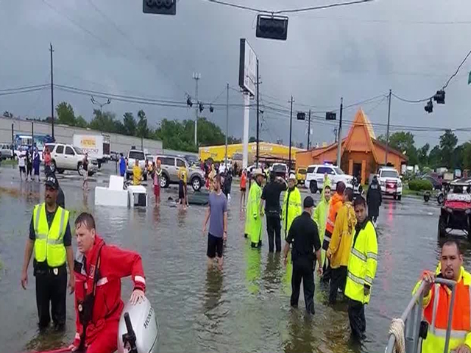
Response
Life safety actions
First responders
Evacuation and shelter decisions
Power outages
Health care facilities - surge
Infrastructure challenges

Slide 10
Local, State, and Federal Government Response
Local – All disasters are local; first assistance will be from local responders
State – Assists local governments with response, communication, and is the liaison to federal government
Federal – State may request the federal government declare a disaster, allowing funding and resource availability to support state need

Slide 11
Additional Disaster Response
Local – local faith-based and other not-for-profit organizations will participate in response and recovery
State – Non-government agencies with a disaster mission will coordinate and collaborate to assist with response and recovery, Florida Voluntary Agencies Active in Disaster (FLVOAD)
Federal – National Non-Government Organizations (NGOs) will be represented at government and community settings to assist with response and recovery:
Emergency Operations Centers (EOCs)
Disaster Recovery Centers (DRCs)
Unmet Needs/Long-Term Recovery committees
Multi-agency response centers (MARC)

Slide 12
Recovery
Bulk distribution: Points of Distribution (PODs)
Debris collection
Individual assistance programs – state and federal
Coordinated county, state, and federal resources
DRCs

Slide 13
Mitigation
Education
Flood zones
Informed decisions on where and how you live
Community rebuilding
Resiliency

Slide 14
Sheltering: General Population Shelters
A shelter is a life raft!
Access/functional needs
Generally, 10-20 square feet per person
Basic first aid/volunteers
Hurricane Ian – 256 shelters – 33,178 people
https://www.floridadisaster.org/planprepare/shelters/
www.FloridaDisaster.org/Counties
Notes:
One thins PCEM wanted to convey clearly – discourage use of shelters
Not enough cots/supplies
Takes all staff to review when registration is late
Has anyone been in a shelter before? Tell us your experience
Look for an officially designated shelter within your county
Floridadisaster.org

Slide 15
Sheltering: Special Needs
This should not be the first option
Special Needs Registry: Requires registration annually
https://snrflhealthresponse.com
Capacity varies by county
Medically fragile
Oxygen dependent
Generator power, including refrigerators
40-60 square feet per person
Caregivers may be necessary
63 Special Needs Shelters opened for Hurricane Ian (over 4,000 individuals and 48 service animals sheltered)
Notes:
One thins PCEM wanted to convey clearly – discourage use of shelters
Not enough cots/supplies
Takes all staff to review when registration is late
Has anyone been in a shelter before? Tell us your experience
Look for an officially designated shelter within your county
Floridadisaster.org

Slide 16
Sheltering Alternatives
Shelter in place when NOT in an evacuation zone
Know your zone – know your home https://www.floridadisaster.org/planprepare/know-your-zone-know-your-home/
Plan to shelter with friends or family
Group homes - use of host home approach preferred
Combines resources
Improves level of supervision/response
Better environment
Place of service flexibility
Notes:
Providers helping providers
“Sister” Group homes – combination of homes when own more than one home
Anxiety/chaos is lessened
Easier to report after event
Providers taking individuals home with their families-

Slide 17
Evacuation Issues
Time - upwards of 20 hours to leave the state
Gas – shortages and high prices
Road rage
Service limitations
Lack of hotel space leads to overuse of shelters
Follow your plan. Know where you are going.
Leave early!
Notes:
Alternative to SPNS, public shelter, shelter in place
Nightmare scenario on the road
6.8 million evacuees – 1/3 of 21 million residents
Leon county filled 10 shelters with mainly people from other counties
Extremes- never evacuating vs. hell yes I’m leaving no matter the circumstances

Slide 18
Explaining the Unexplainable:
Helping Children
Understand Disasters
A Child’s Situation
Aware of what is going on
Disruption of life as they know it
Feel helpless, stressed, and in disarray
Loss of routine and comfort
Need a safe space
People sleeping in their school
Everyone around them is stressed
What Can We Do?
Let them help in recovery
Let them talk, or process through play and art
Validate their feelings
Don’t pretend everything is OK
Provide safe, kid-friendly, low-tech activities
Love them through it!

Slide 19
Roles of APD
Follow the APD Comprehensive Emergency Management Plan (CEMP)
Defines concept of operations
Mission essential functions
Identifies Incident Management Team
Alternative locations: Continuity of Operations Plan (COOP)
Designated 24/7 representation at the State Emergency Operations Center (SEOC)
Communicate essential information to consumers, providers, Waiver Support Coordinators (WSCs), and staff
Work with partner agencies
Problem solve throughout the disaster cycle
Notes:
All agencies have a Concept of Operations Plan (similar template)
Know those that you interact with
Update at least annually – no dust!
Identify essential stuff
IMT – Incident Management Team (Logistics, Communications, Operations)
Guides what occurs before, during, and after event
People with power, no laptops.
Loss of power – huge impact

Slide 20
Information is Key!!
Gather high level of information and problem solve
Communicate essential information
WSCs and providers
Licensed group homes
Supported living
Family home
APD-operated facilities
Notes:
In order to have valid SITREP / Battle rhythm calls, large amount of intelligence gathered
Maintain Licensed home list (400+)
WSC – for each consumer they serve – with family home
Suncoast mock drill last year – training 80-90% tracked down very few sheet in Sept (IRMA)
Good Information, excellent communication let to even with no major incidents/loss of life
Sitreps – capture information by County/Region:
Evacuation
Special Needs
Contacts and communication
Living settings

Slide 21
Response and Recovery Resources
Local and state emergency management: https://floridadisaster.org/
Florida Department of Health: http://www.floridahealth.gov/
APD website - Recovery Toolkit and Resource Directory
http://www.apdcares.org/news/toolkit.htm
https://resourcedirectory.apd.myflorida.com/resourcedirectory/
Everbridge – emergency notification system
Shared news releases
APD communication
Notes:
Assess – Good/Bad
Access local information relevant to you

Slide 22
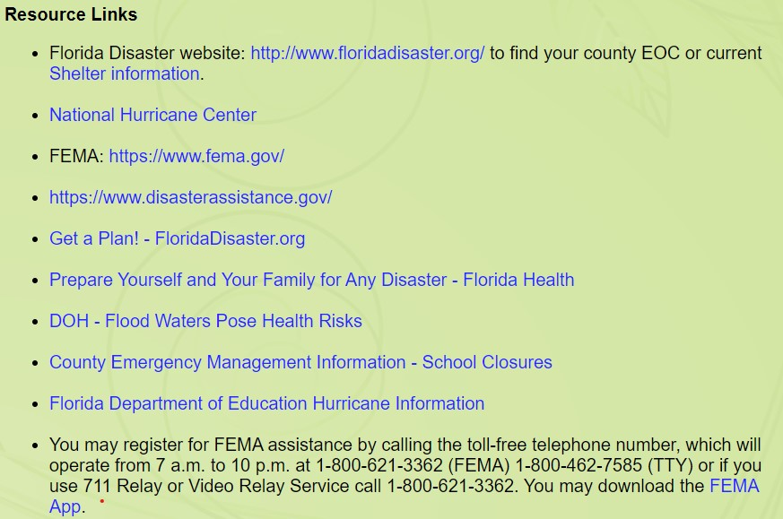
Disaster Preparedness
and Recovery
apdcares.org/news/toolkit.htm
Notes:
Assess – Good/Bad
Access local information relevant to you

Slide 23
Disaster Planning is Essential
A disaster plan is a living document.
EVERYONE needs a disaster plan!
Be sure those tasked with a role in your plan are aware and remain available.
Your disaster plan should include:
How to meet your communication needs
What your evacuation and shelter plans are
How to meet your transportation needs
Update and practice your disaster plan annually.
We’re in this together!
Notes:
Information overload at times.
Easy to dismiss/complacent
Revise, Revise, Revise – update condition, supports, resources
Irma – should help with good plans this year
Many templates aside from FDDC handout.
Main Resource: ready.gov; fema.gov; floridadisaster.org
Drive to find weak spots in plan

Slide 24
Thank You!
Karen Hagan
Emergency Coordination Officer
State Office
(850) 412-0085
Karen.Hagan@apdcares.org
Michael Taylor
Regional Operations Manager
Suncoast Region
(813) 233-4311
Michael.Taylor@apdcares.org
For additional information about APD, please call our State Office at 1-866-APD-CARES (1-866-273-2273) or visit our website at www.apdcares.org.
Notes:
Information overload at times.
Easy to dismiss/complacent
Revise, Revise, Revise – update condition, supports, resources
Irma – should help with good plans this year
Many templates aside from FDDC handout.
Main Resource: ready.gov; fema.gov; floridadisaster.org
Drive to find weak spots in plan

